Slide 1
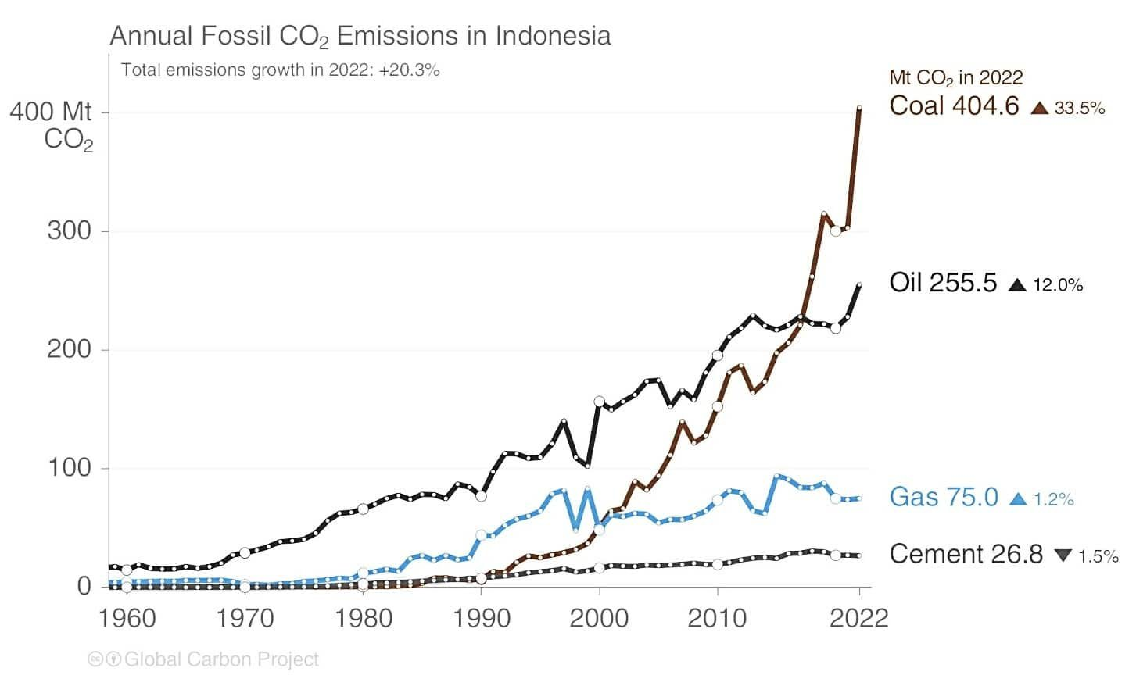
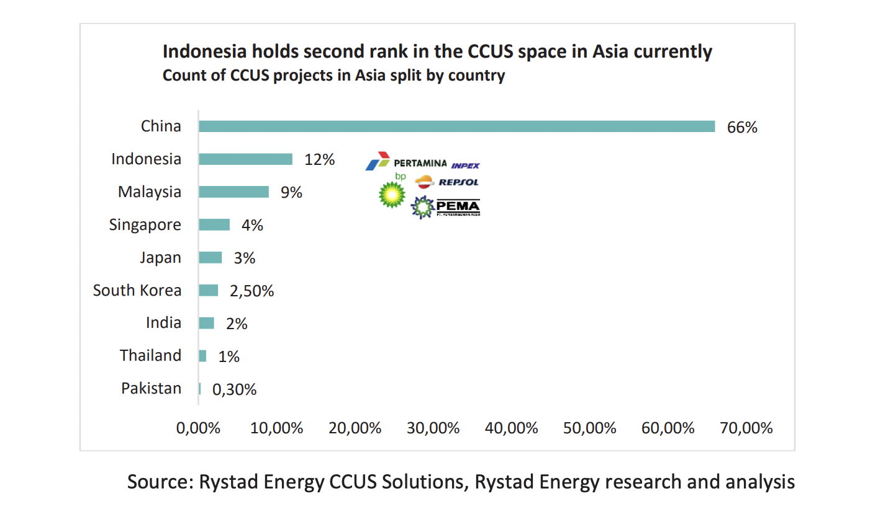
Unveiling CCUS : Indonesia’s Path to Carbon Neutrality
1
Indonesia’s current energy is dominated by fossil fuels (coal, crude oil and natural gas) meeting around 84% of the national energy demand with coal being the largest source for CO2 emissions accounting for 1/3rd of annual CO2 emissions.
4
Indonesia, with a potential CO2 storage capacity of 400 to 600 gigatons in depleted reservoirs and saline aquifers, stands at the forefront of the green industrial era. This potential allows national CO2 emissions to be stored for 322 to 482 years, with an estimated peak emission of 1.2 gigatons of CO2-equivalent in 2030.
2
To meet this rising energy demand, the country stands at a crossroads: utilise more of its domestic coal resources, while also turning to international oil and gas markets to import energy from oversees; or pursue the huge untapped potential of renewable sources that can provide local and affordable solutions to fossil fuels.
5
However, even if Indonesia uses only its depleted oil and gas fields it still has a staggering storage potential of 8 gigatons. Indonesia is currently in the forefront in the commercial CCUS landscape of Southeast Asia comprising of 55% of the total projects, followed by Malaysia with another 33%.
3
Studies shows that it is cheaper to do the latter, with the share of renewable energy reaching two-thirds of the country’s energy mix in 2050, up from just 14% today. Therefore, CCUS will prove to be of immense importance to facilitate this transition from fossil fuels to renewable energy, and looking at the potential of Indonesia’s storage capacity it is quite possible.
6
Statistically 2022 onward till date, Indonesia has registered a massive 114% growth in new CCUS project announcement compared to pre 2022 timeframe. Indonesia is expected to require only half of its storage capacity of eight gigatonnes of carbon in the depleted reservoirs, while an additional 400 gigatonnes of storage capacity is available if it utilises its saline aquifers.

Slide 2
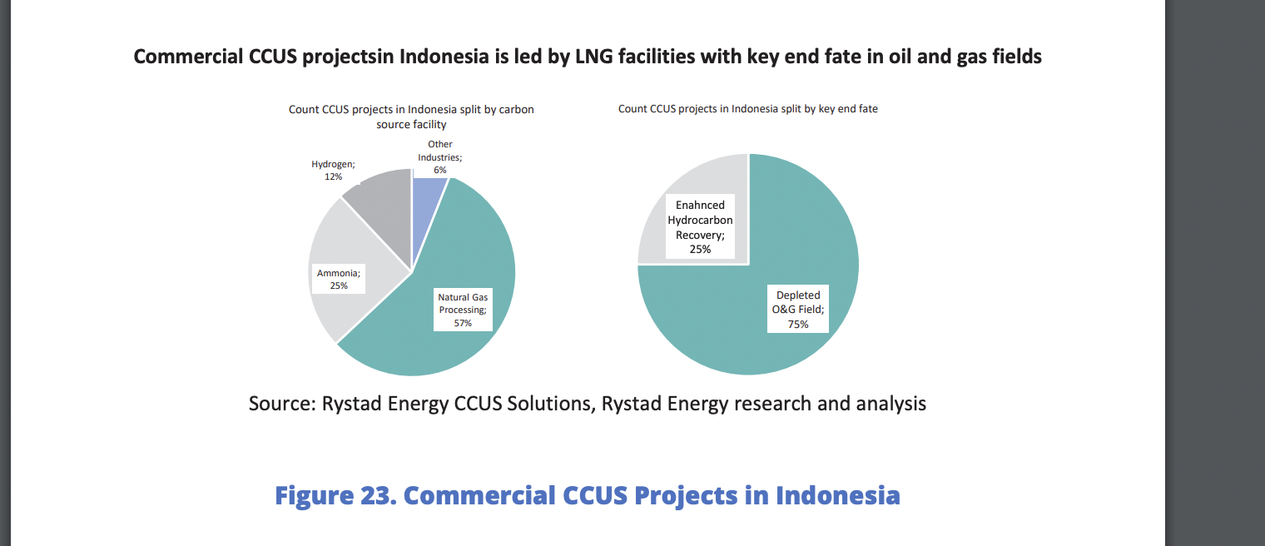
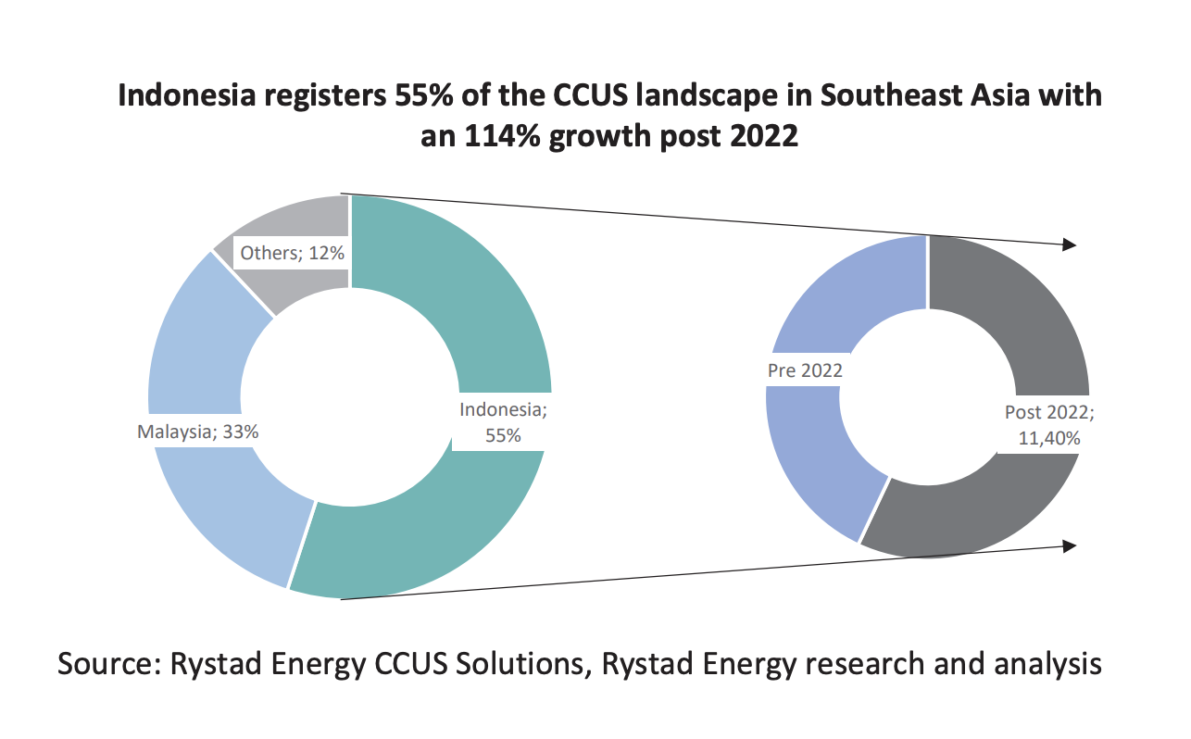
Unveiling CCUS : Indonesia’s Path to Carbon Neutrality
Indonesia can leverage its vast CO2 storage capacity to provide safe storage for CO2 from countries like Japan, South Korea, and Singapore.
Partnerships with companies like Pertamina indicate the potential for Indonesia to establish a carbon storage hub, creating a viable business market. This could generate revenue by offering CO2 sequestration sites to foreign countries seeking favorable storage locations.
Regarding this, Indonesia has issued a presidential regulation regarding carbon capture and storage (CCS), allowing CCS operators to set aside 30% of their storage capacity for imported carbon dioxide, with Indonesian government collecting royalties from storage fees charged by the CCS operators.
To store carbon from overseas, Indonesia would only permit emitters that have invested in the country or are affiliated with companies that have done so, and the government must have a bilateral agreement with the government where the emission came from.
Indonesia is currently in the forefront in the commercial CCUS landscape of Southeast Asia comprising of 55% of the total projects, followed by Malaysia with another 33%.
Statistically 2022 onward till date, Indonesia has registered a massive 114% growth in new CCUS project announcement compared to pre 2022 timeframe.
Statistically, we can expect at least a 200% growth in new projects in the upcoming years once alliances realize into full scale commercial projects. This is thereby likely to play a pivotal role to shape up the national CCUS game quite significantly.
40% of the total CCUS projects in the country is dominated by INOC Pertamina, followed by other companies including Repsol, BP, Inpex etc.

Slide 3
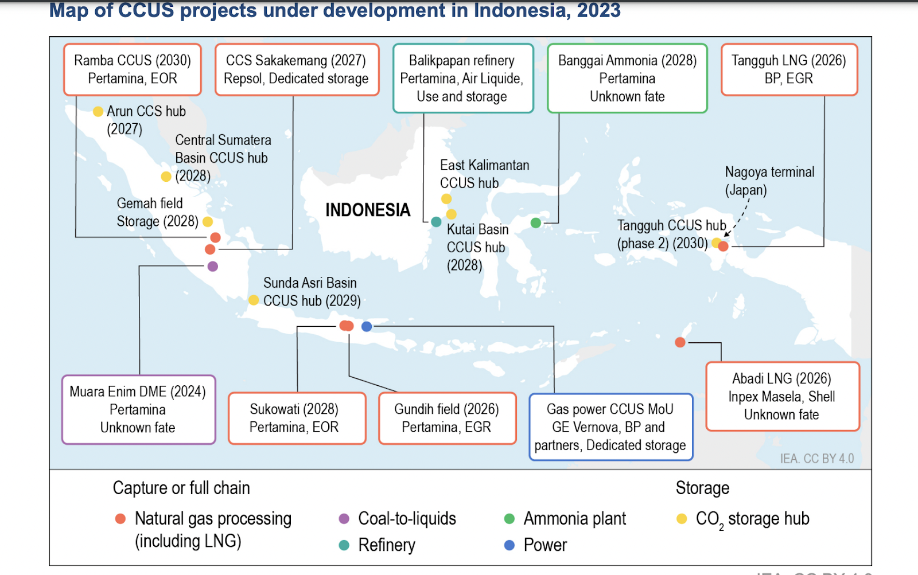
Energy Ministry data indicates there are 15 CCS and CCUS projects in various stages of preparation in Indonesia with a combined investment of nearly US$8 billion, including BP’s project.
Exxon Mobil plans to invest up to $15bn to develop petrochemical project and carbon capture and storage (CCS) facilities in Indonesia
Indonesian state energy company Pertamina and Exxon also agreed to assess investments of $2bn for the development of CCS facilities utilising two underground basins in the Java Sea.
Pertamina said that the proposed CCS hub will have potential storage capacity of at least three gigatons of carbon dioxide (CO₂).
BP expects that completion for Tangguh is targeted for 2026 or 2027 and, by that time, 4 million metric tons of carbon dioxide will be injected back into the reservoir annually, with the amount reaching a total of up to 25 million metric tons of carbon dioxide by 2035 and 33 million metric tons by 2045.
He added that through enhanced gas recovery and by sequestering the carbon dioxide, Tangguh operators will potentially gain up to 300 billion cubic feet of incremental gas in 2035 and as much as 520 billion cubic feet in 2045.
Tangguh is the largest gas producer in Indonesia, generating 1.4 billion standard cubic feet of gas per day, or up to 20% of the country's daily gas production. BP and its partners are working on increasing Tangguh's production capacity to 2.1 billion standard cubic feet of gas per day.
Pioneering Projects: The Rise of CCUS in Indonesia

Slide 4
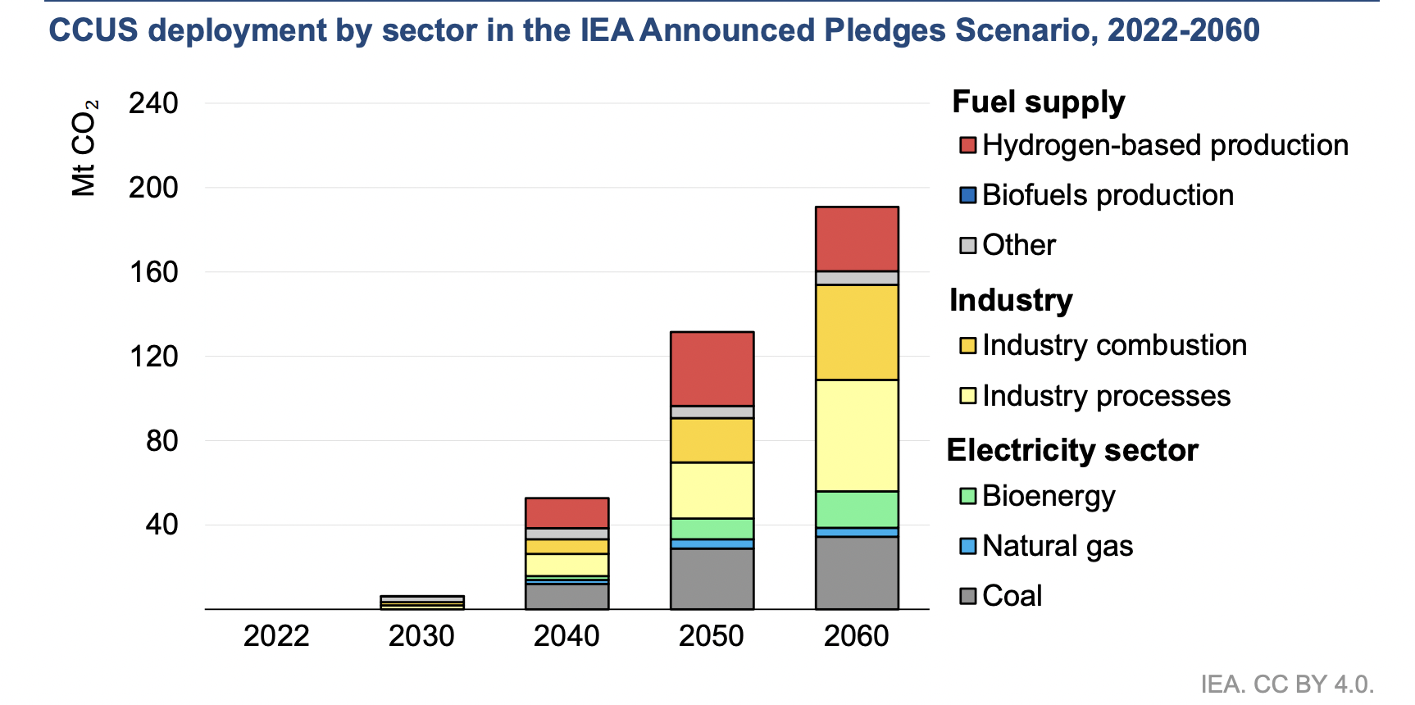
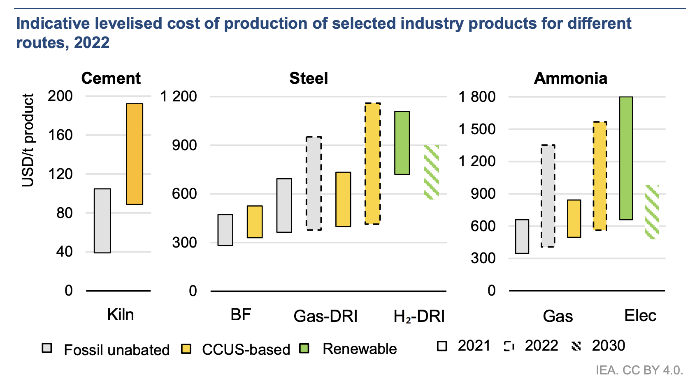
The Future of CCUS in Indonesia
57% of the carbon source associated with the projects are from natural gas processing facilities.
This is followed by the remaining 43% across different segments of industry including ammonia production, paper production and other chemicals.
CCUS is still lacking in one of the most emission intensive sector – power plants.
Over a third of Indonesia's energy sector emissions come from the power sector, with 85% from coal-based generation. The average age of the coal fleet is 13 years, and new plants continue to be built.
Supercritical and ultra-supercritical power plants, which constitute about 20% of Indonesia's coal fleet, are more efficient and suitable for CCUS retrofits. These large-scale, recently built plants could serve as anchor projects for developing CO2 storage hubs.
Cement production
Largest industrial emitter in Indonesia, with two-thirds of the sector’s direct emissions originating from clinker production.
30 major cement plants, which emit around 45 Mt CO2 per year.
Iron and steel production
CCUS can be a cost-effective route to decarbonise.
6 large-scale steel mills with annual CO2 emissions of around
30 Mt CO2.
Ammonia production
CCUS can also be a cost-effective solution for low-emissions ammonia production. Japan and Indonesia signed a Memorandum of Co-operation (MoU) in 2022 leading to a joint CCUS study on a 0.7 Mt ammonia plant in Central Sulawesi.

Slide 5
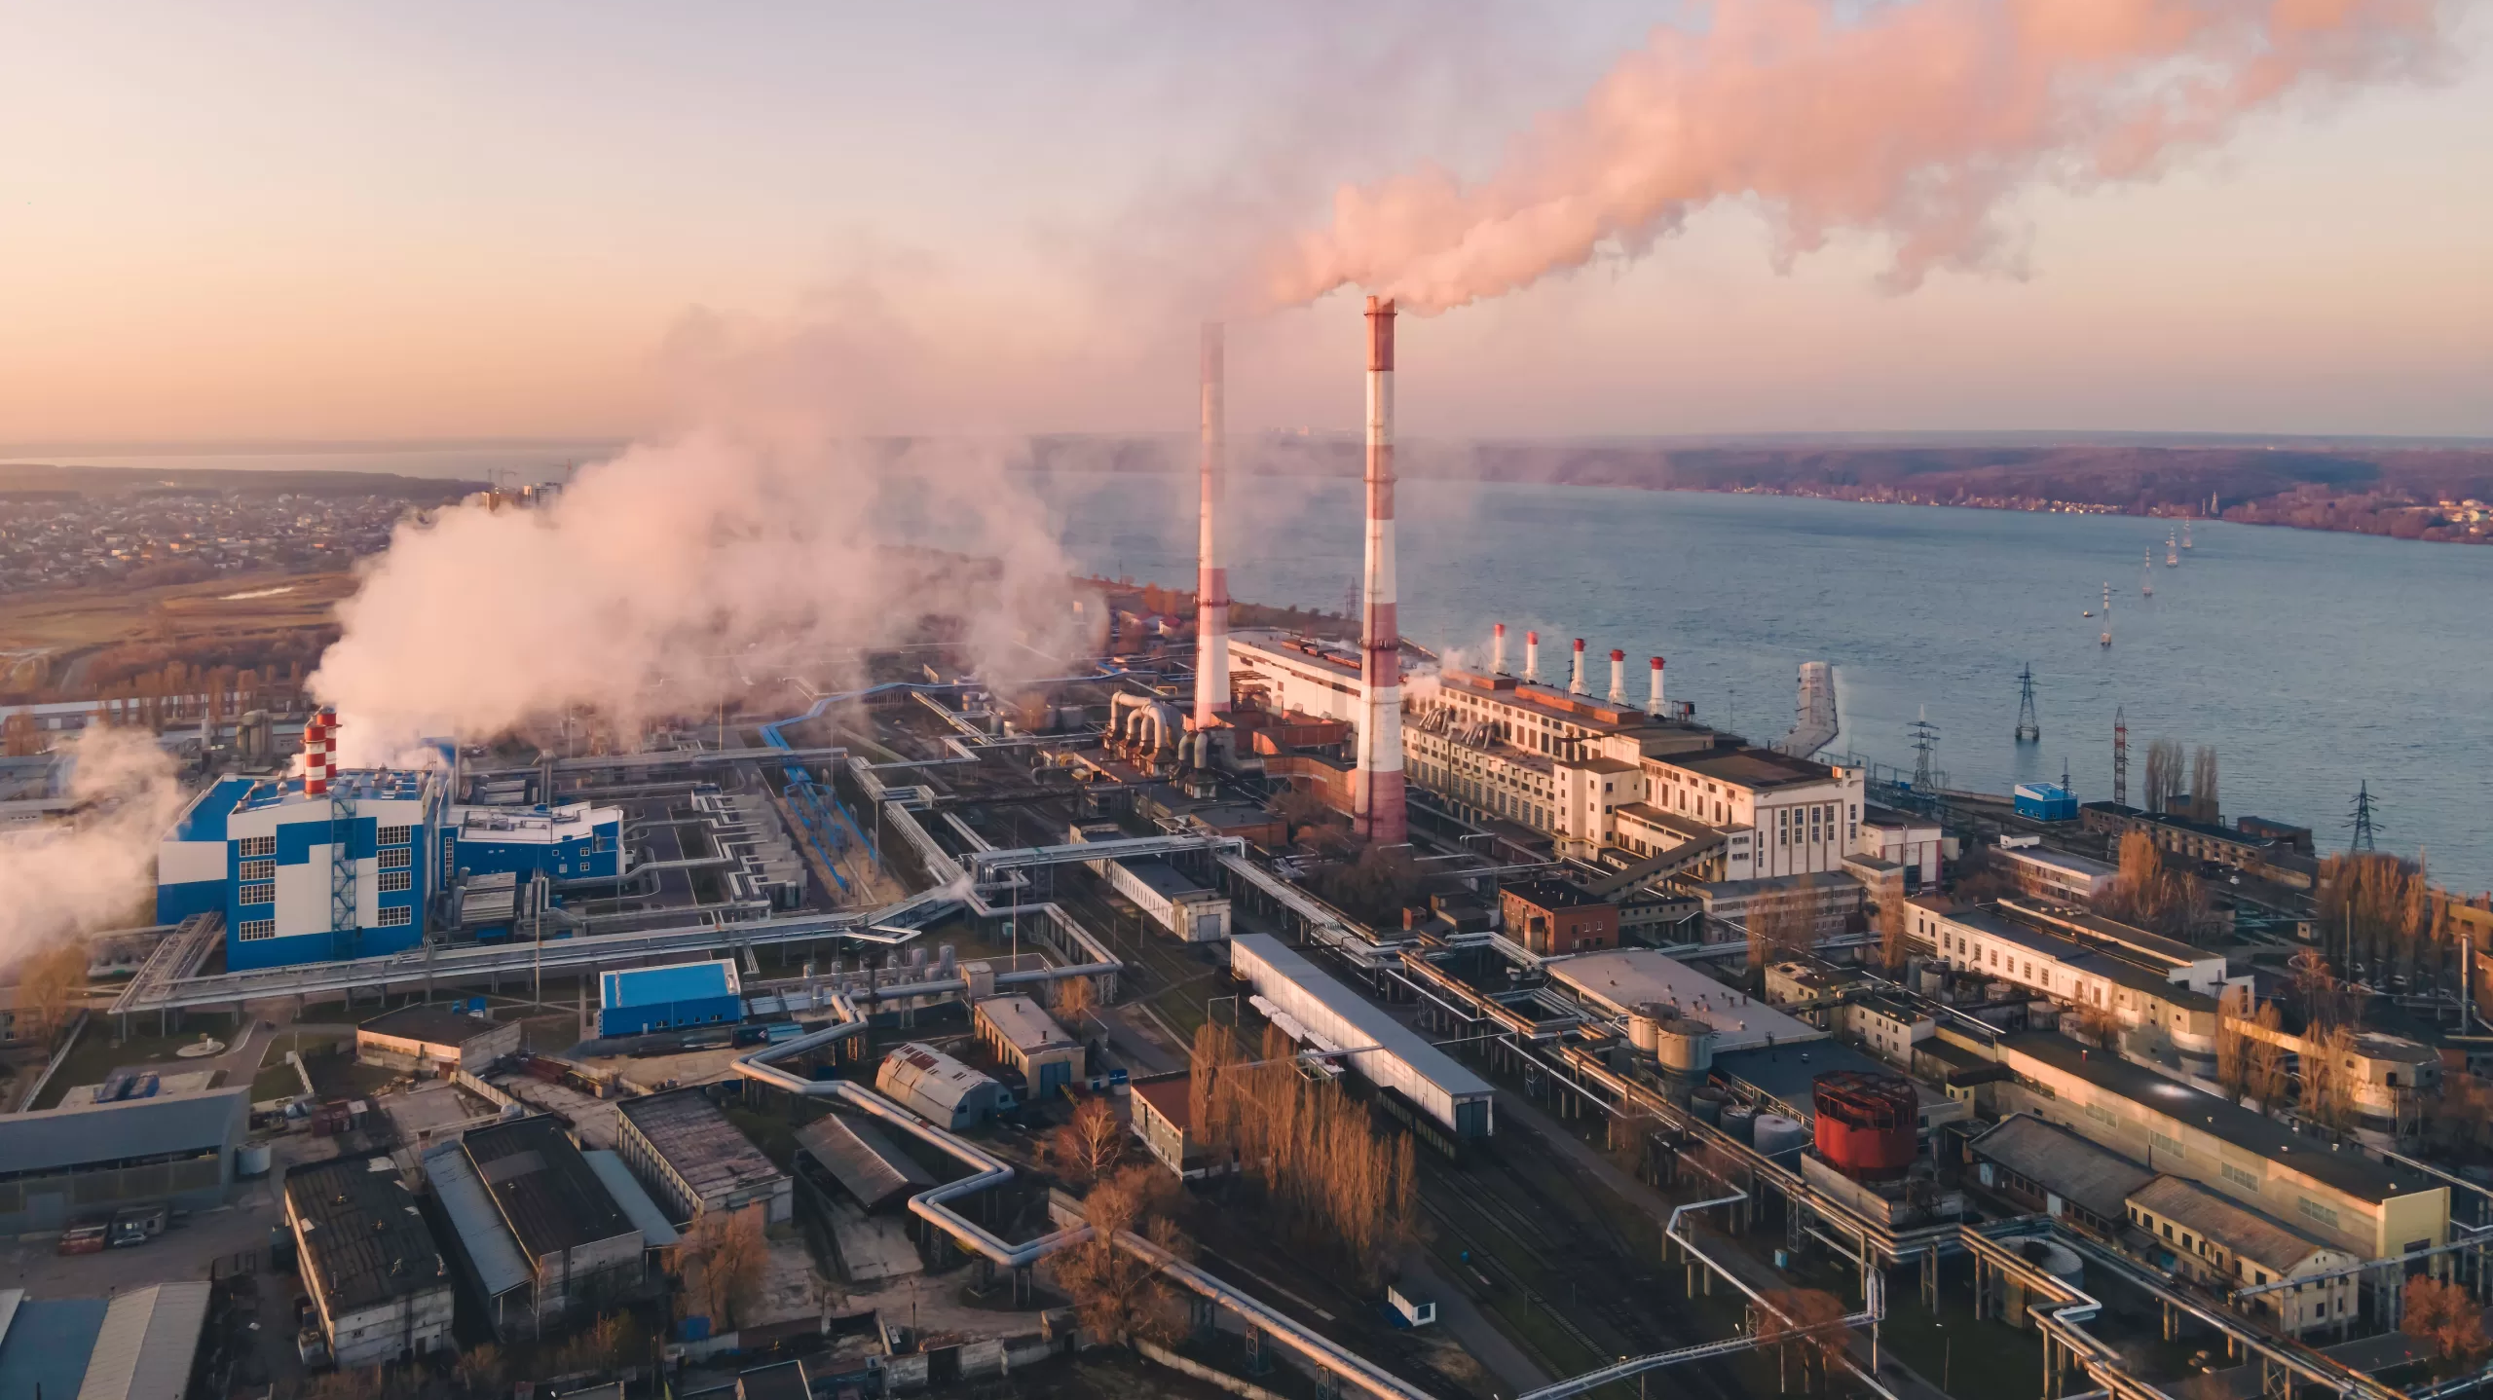
CCUS Framework Indonesia
MEMR 2/2023
Indonesia has established a pioneering legal and regulatory framework for Carbon Capture, Utilization, and Storage (CCUS) with the Ministry of Energy and Mineral Resources Regulation Number 2 of 2023 (MEMR 2/2023), finalized in March 2023.
This makes Indonesia the first country in Southeast Asia to implement such a framework. MEMR 2/2023 addresses key areas like detailed monitoring and reporting requirements essential for safe CO2 storage.
It relies on upstream exploration and production companies to lead CCUS development and operations due to their expertise in large-scale projects and subsurface knowledge.
MEMR 2/2023 is built on Indonesia’s oil and gas regulatory framework and allows only oil and gas contractors to develop CCUS projects. This limitation stems from the regulation’s scope, confined to the ministry’s jurisdiction, unlike broader legislation seen in other regions.
Changes Required
To maximize CCUS's role in Indonesia’s decarbonization, additional regulations are needed to expand the framework beyond the oil and gas sector. These should cover:
CO2 Storage Development Outside Oil and Gas Areas: Creating frameworks for defining, licensing, permitting, monitoring, and regulating CO2 storage outside oil and gas zones.
Inclusion of Non-Oil and Gas Companies: Developing regulations for non-oil and gas companies to participate in CO2 transport and storage, fostering CO2 storage hubs.
International Implications: Addressing cross-border projects and international regulations, considering Indonesia's potential to support regional and global decarbonization.
4. Monetization of Carbon Credits: Ensuring a robust methodology for generating and trading CCUS-enabled carbon credits to meet emissions reduction targets and monetize credits from CO2 captured outside the oil and gas sector.
In summary, Indonesia’s MEMR 2/2023 is a pioneering step for CCUS in Southeast Asia, establishing essential regulatory frameworks for CO2 storage.
However, to enable broader participation and fully realize the potential of CCUS in Indonesia’s decarbonization strategy, further regulations are needed to expand the scope beyond the oil and gas sector, address international collaborations, and develop robust methodologies for carbon credit monetization.
Indonesia can follow suit of legislations in other countries like the CCS Directive in the European Union and Australia's Offshore Petroleum and Greenhouse Gas Storage Act 2006.

